Slide 1
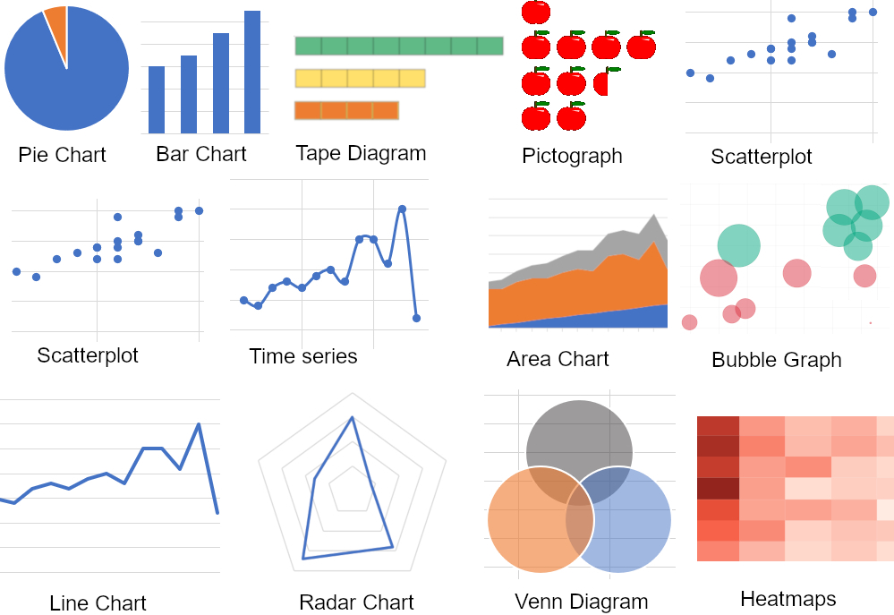
Visualizing Data with Graphs & Normality Testing

Slide 2
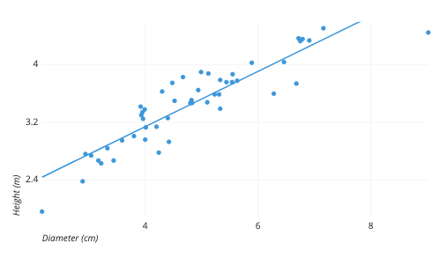
Visualizing Relations

Slide 3
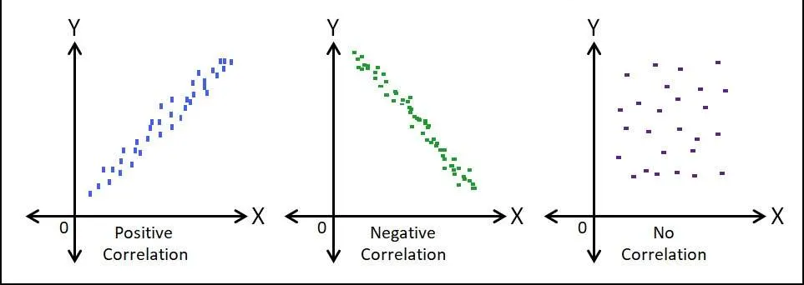
Data Visualization
Graphs before stats!
SUPER important to do before conducting any statistical analysis
What it does do: provides idea of what to expect in the data
What it does NOT do: provide statistical/practical significance in the data

Slide 4
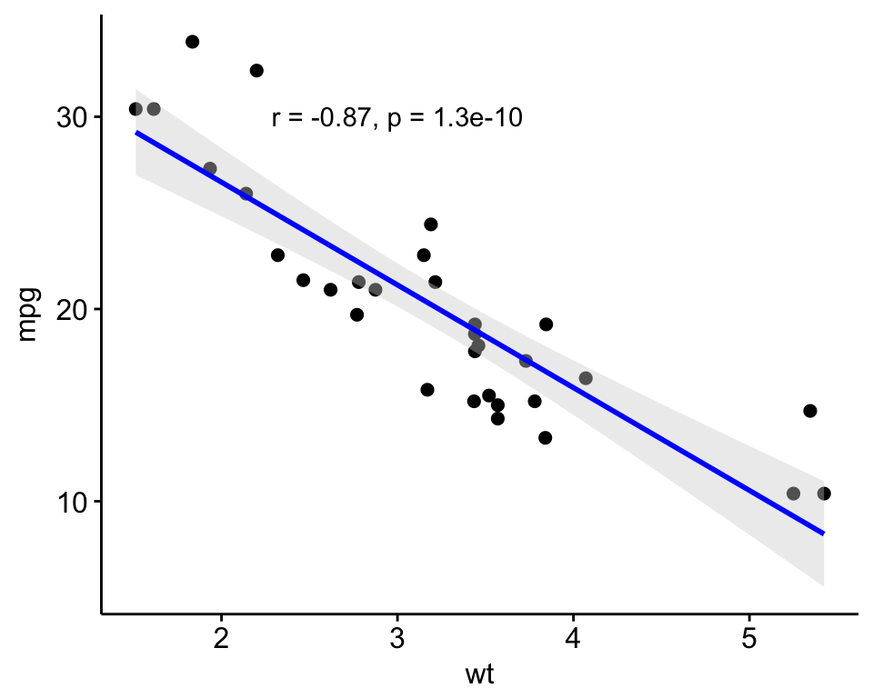
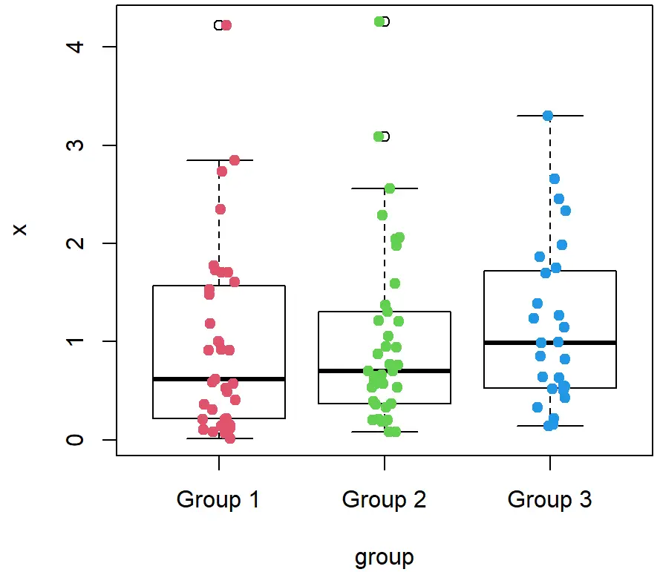
Gold Standard for Data Visualization
For linear data to analyze associations or predictions, use scatterplots
  Good for correlations, regressions
For data between/within groups to analyze mean differences, use boxplots
  Good for t-tests, ANOVAs

Slide 5

Practice Data Visualization: SPSS

Slide 6
Scatterplot
Graphs > Scatter/dot
  Simple scatter > define
  Move 1 variable into the X axis and one into the Y axis (doesn’t matter which)
    Use Height as X and preweight for Y
  Click OK
  Then, let’s add a regression line of best fit
    Left click twice on the graph
    Click Elements > Fit Line at Total > Close

Slide 7
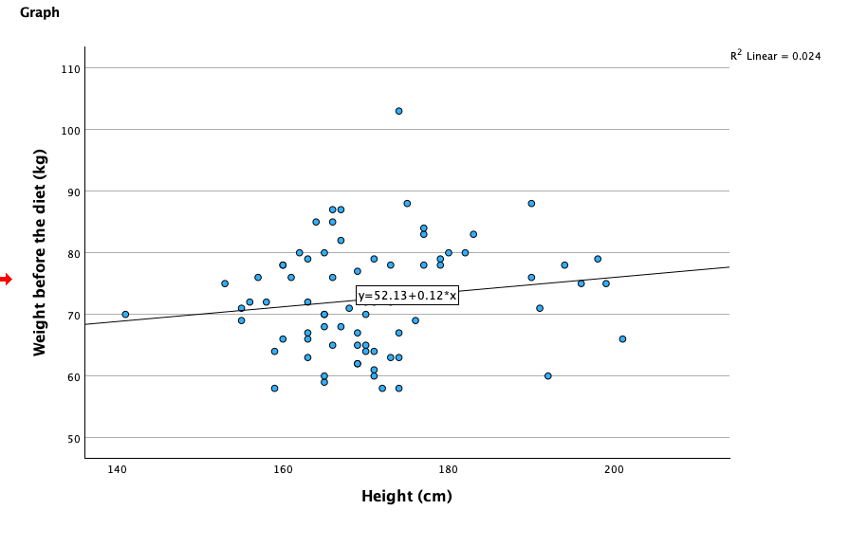

Slide 8
Boxplot
Graphs > Boxplot
Define (keep defaults)
Variable: WeightLOST (DV)
Category axis: diet (IV, grouping variable)

Slide 9
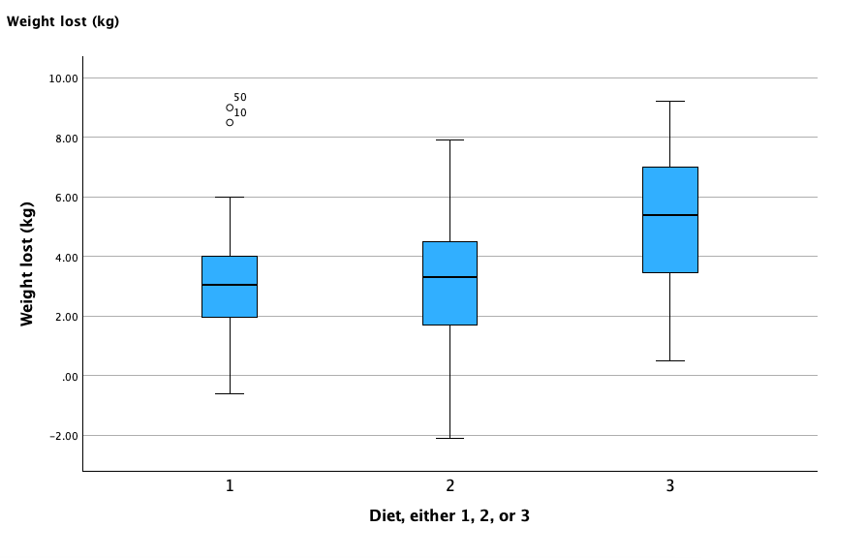
What can you tell by looking at this graph?

Slide 10
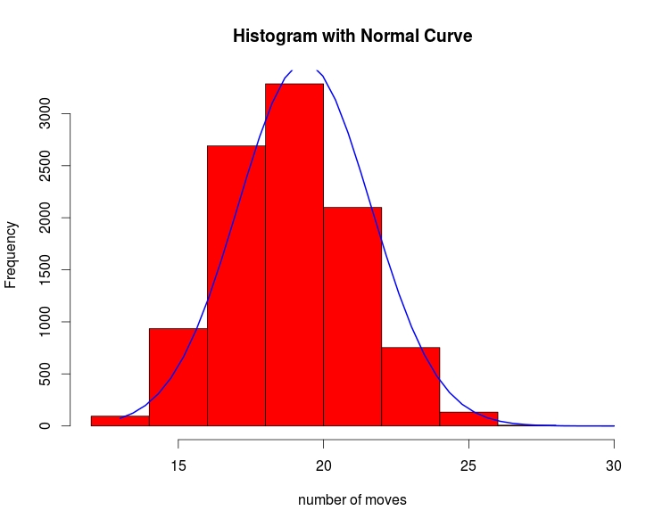
Normality Testing

Slide 11
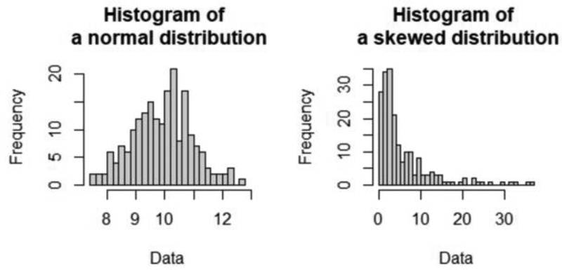
What is Normality Testing?
Method used to ensure that data are normally distributed, which is a core assumption to many statistical analyses--only with quantitative variables
If data are normally distributed, we are good to go
If data are not normally distributed, we will have to proceed with caution

Slide 12
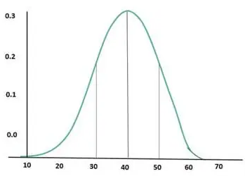
How Do We Test for Normality?
Visualize data with a histogram
Check skewness and kurtosis
Run the Shapiro-Wilk Test for Normality

Slide 13
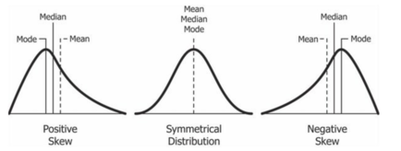
What is Skewness?
Measurement of the distortion of symmetrical distribution or asymmetry in a data set

Slide 14
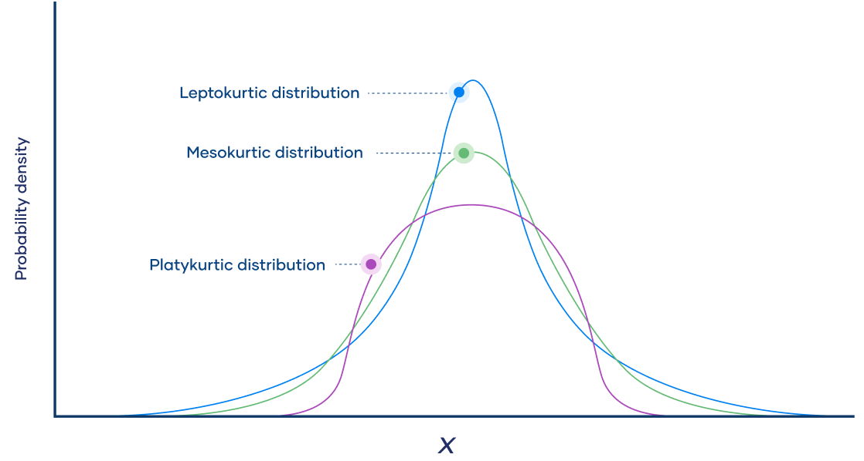
What is Kurtosis?
Kurtosis is a measure of the combined weight of a distribution's tails relative to the center of the distribution curve (the mean)
Goal: mesokurtic

Slide 15
Practice Normality Testing: SPSS

Slide 16
Step 1: Make a Histogram
Graphs > Histogram
Variable: WeightLOST
  Check display normal curve
Click OK

Slide 17
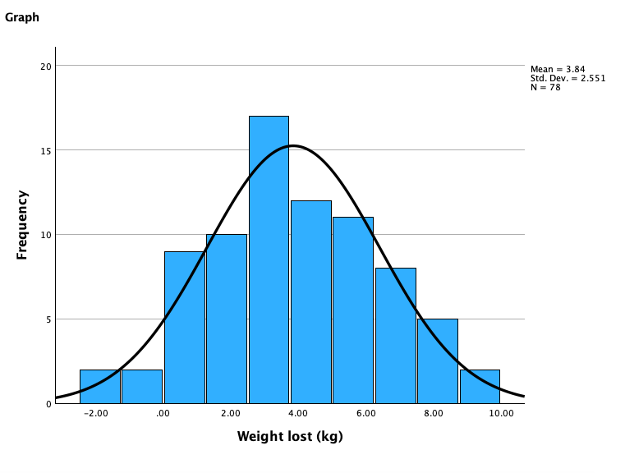

Slide 18
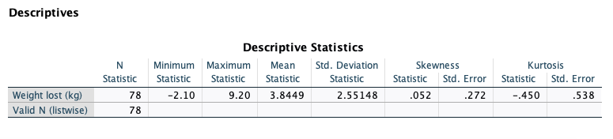
Step 2: Check Skewness and Kurtosis
Analyze > Descriptive Statistics > Descriptives
Options > check Skewness and Kurtosis
Click OK
Skewness & Kurtosis acceptable range: -2 - +2
Different researchers will give different ranges, but to really know, run the Shapiro-Wilk test

Slide 19
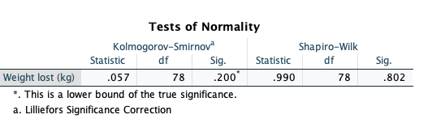
Step 3: Run the Shapiro-Wilk Test for Normality
Analyze > Descriptives > Explore
Dependent list: WeightLOST
Plots > check Normality plots with tests
Note: SPSS will provide a bunch of output, but this is what really matters:
Significant? What does this mean?

Slide 20
What Do We Do If We Violate Normality?
Huge bummer–but not the end of the world
We won’t be able to analyze the statistics using any analysis we will discuss in this class because they require the assumption of normality :(
But, there are specialized non-parametric tests that do not require the assumption of normality
  There is one for every test we’ll discuss in this class
Remember: normality testing is one of the instances where we do NOT want p < .05! If this happens, data are not normally distributed
If p > .05, we’re in the clear: data are normally distributed, proceed as usual

Slide 21
Analyses to Use When Normality Has Been Violated
Pearson correlation → Spearman correlation
Simple/multiple linear regression → Spearman correlation
Independent samples t-test: Mann-Whitney U test AKA Wilcoxon test
Paired samples t-test: Wilcoxon signed-rank test
One-Way and Two-Way ANOVA: Kruskal-Wallis Test
Repeated measures ANOVA: Friedman’s Test

Slide 22
Note
To copy output into word doc:
  Right click on table/piece of output wanting to copy
  Select Copy As
  In new dialog box, make sure ‘image’ is check marked
  Press ‘OK’
  In a Word file, right click and choose ‘paste image’
  You’ll need to do this for all your homework!

